Slide 1
Data Mining: case study

Slide 2
Agenda
Introduction
Business Understanding
Data Understanding
Data Preparation
Clustering analysis
Association rules

Slide 3
Business Understanding

Slide 4
Business objective
We want to analyze water meters located in NYC in during 2012-2020. Our goal is to understand patterns related to them in order to, possibly enter this segment of market.
Data mining goals
Discover segments in meter data
Analyze the semantic of these segment, trying to find interesting patterns

Slide 5
Data Understanding

Slide 6
Data collection and quality
Data has been collected from a Kaggle dataset that stored the [2012-2020] version of the water consumption dataset of NYC Open data
The dataset presented 24 fields, each one of them is explained in the file dict.xlsx
The real problem was about completeness: there were missing values for meters numbers and their location
Another problem was that the unit of analysis of the dataset was a specific water consumption, and not the specific meter we want to analyze.
An early exploration showed many redundancies and unbalanced categorical features, as long as many of them representing ids (useless)
When Boroughs = FHA after a brief search I discovered that related developments are part of QUEENS administration but under control of FHA

Slide 7
Data Preparation

Slide 8
Pre-processing strategy
It’s obvious that if we want to analyze meters, we must aggregate data by its id
For every different meters we want to get overall:
Consumptions
Charges
Total number of days in which the meter is active
First and last service date
And others

Slide 9
Pre-processing strategy
It is not possible to aggregate if missing features aren’t handled. Most of them like TDS #, and rate class are handled with a simple imputation.
Imputing meter number and location was a bit difficult. Exploring I understood that every different meter should be placed on a different location that could be obviously served by different meters.
I used this relationship to impute meters.
Assumpion: since there is no other way to be sure about how many different locations are marked with a NaN, we will assume that in this cases a single building instance is associated with a single meter.

Slide 10
Pre-processing strategy: features
A good number of features like AMP #, EDP were removed since TDS # was already enough to identify a development;
Other features with loads of category with low value counts (with a single dominant category) have been turned to Boolean
Charges are divided in Current, Water&Sewer and Others, where Current is the sum of the last two. I removed the second one, using Others as a Boolean indicator (since there were not much values)

Slide 11
Pre-processing strategy: pipeline
Using the base dataset impute missing features
Aggregate the dataset by meter number
Engineer new features for the aggregated dataset (strategy are reported on the pre-processing tab of dict.xlsx):
Estimated score = n_estimated / n_readings
Bill analyzed score = n_analysis / n_readings
Building = TDS# +Location
Location category
Development type

Slide 12
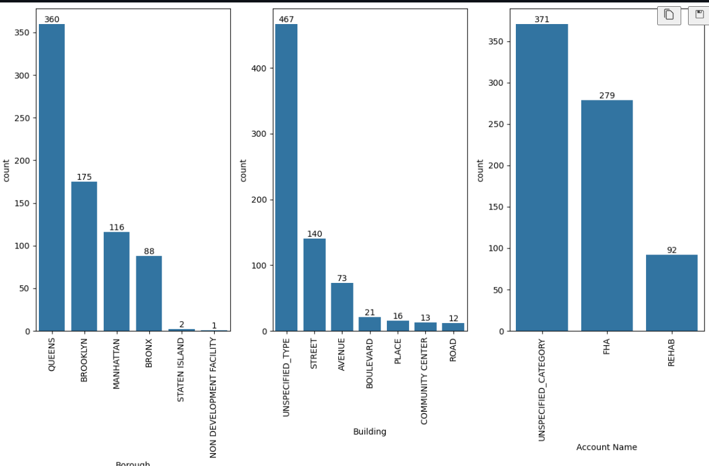
After the aggregation…

Slide 13
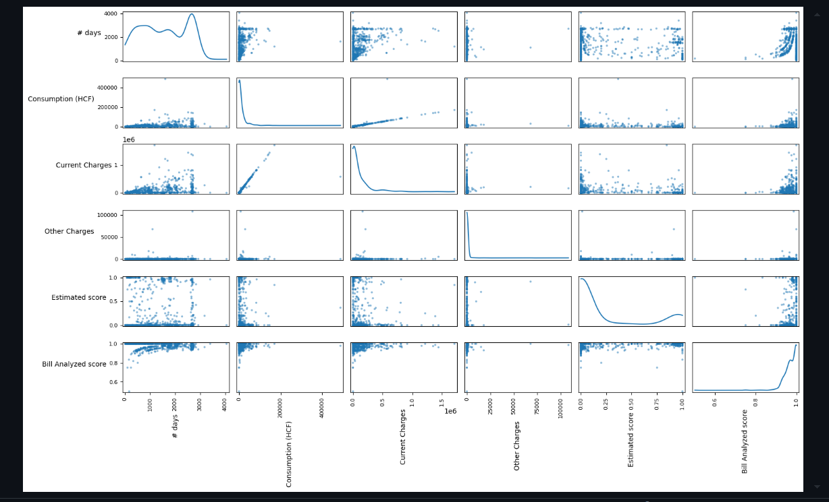
After the aggregation…

Slide 14
Data encoding for clustering
For clustering purposes the data needs to be numeric. Since One hot encoding would have resulted in a very sparse representation i opted for Count Encoding from feature_engine library.
How to treat dates?
Divide each date field in day month year (derive three features)
Apply a CyclicEncoding on month and day to preserve their structure
The last step will derive two features for day and two features for month based on sin and cos transformations

Slide 15
Data encoding for association rules
To discover frequent pattern every instance on the original pre processed dataset needs to be One Hot Encoded (categorical)
For numerical features i defined a number of bins in equal frequency. I decided 5 bins for consumptions and charges features, and 3 bins for #_days
Only the scores could not be handled this way. So i used the classic equal-width tecnique with Friedman rule to decide the correct number of bins
After binning i applied the classic One hot encoding

Slide 16
Clustering

Slide 17
Outliers?
After the aggregations the number of instances was quite low: 742. I decided to keep outliers, to not reduce even further instances’ number
Instead i opted for scikit RobustScaler for the heavy tailed numerical distributions

Slide 18
Clustering types
I tried with different configurations:
K-Means with and without dimensionality reduction
Agglomerative single linkage and ward linkage with and without dimensionality reduction
DBSCAN with non-linear dimensionality reduction

Slide 19
Dimensionality reduction
When applied clustering with dimensionality reduction i applied two tecniques:
PCA (n_components = 2) => it explain over 99% of the data variance
Kernel PCA (n_components = 2, kernel = rbf, gamma=1/n_features) => better clustering results

Slide 20
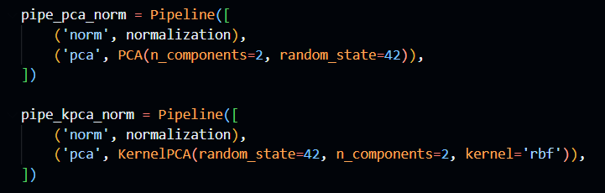
Pipelines

Slide 21
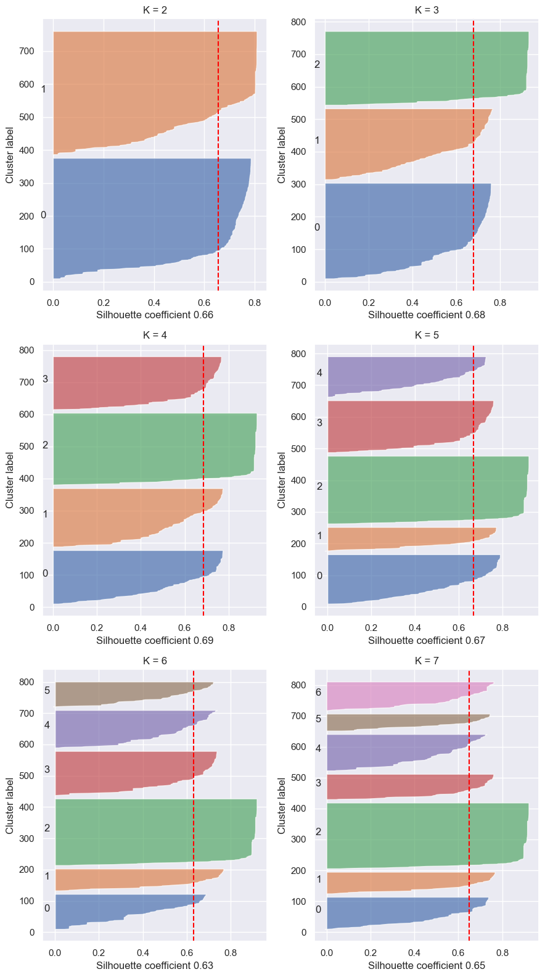
K Means PCA

Slide 22
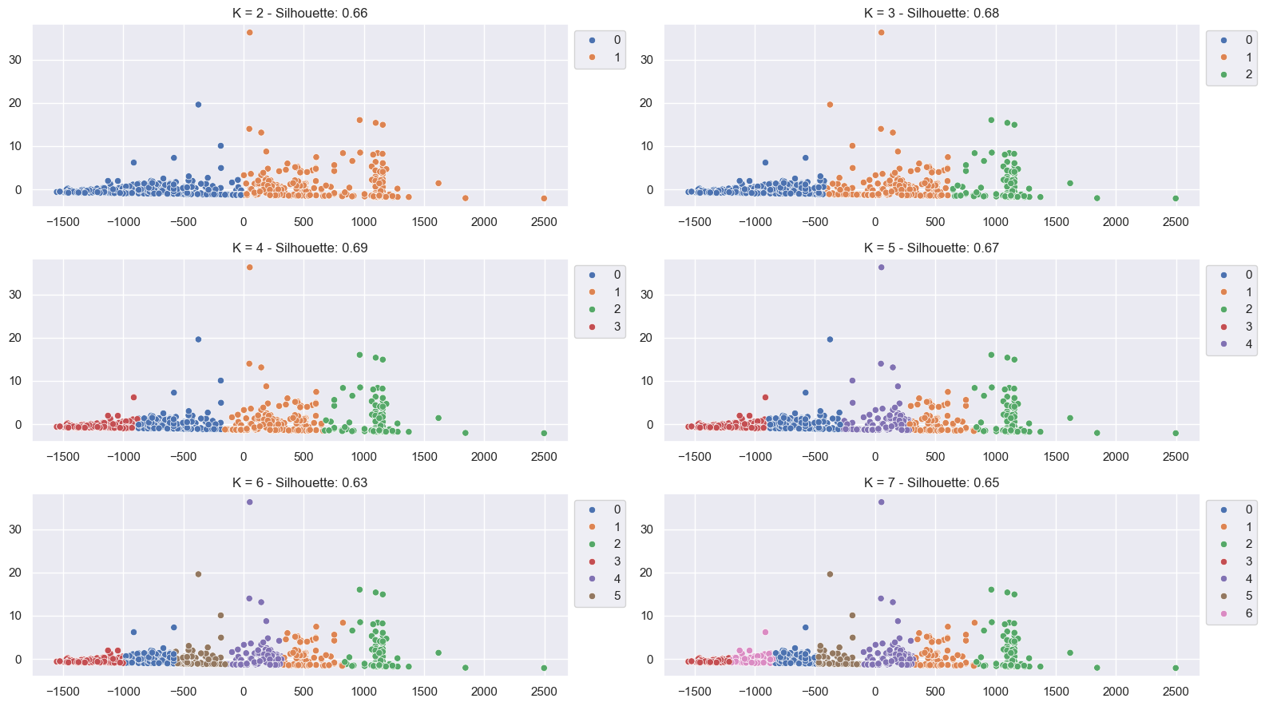
K Means PCA

Slide 23
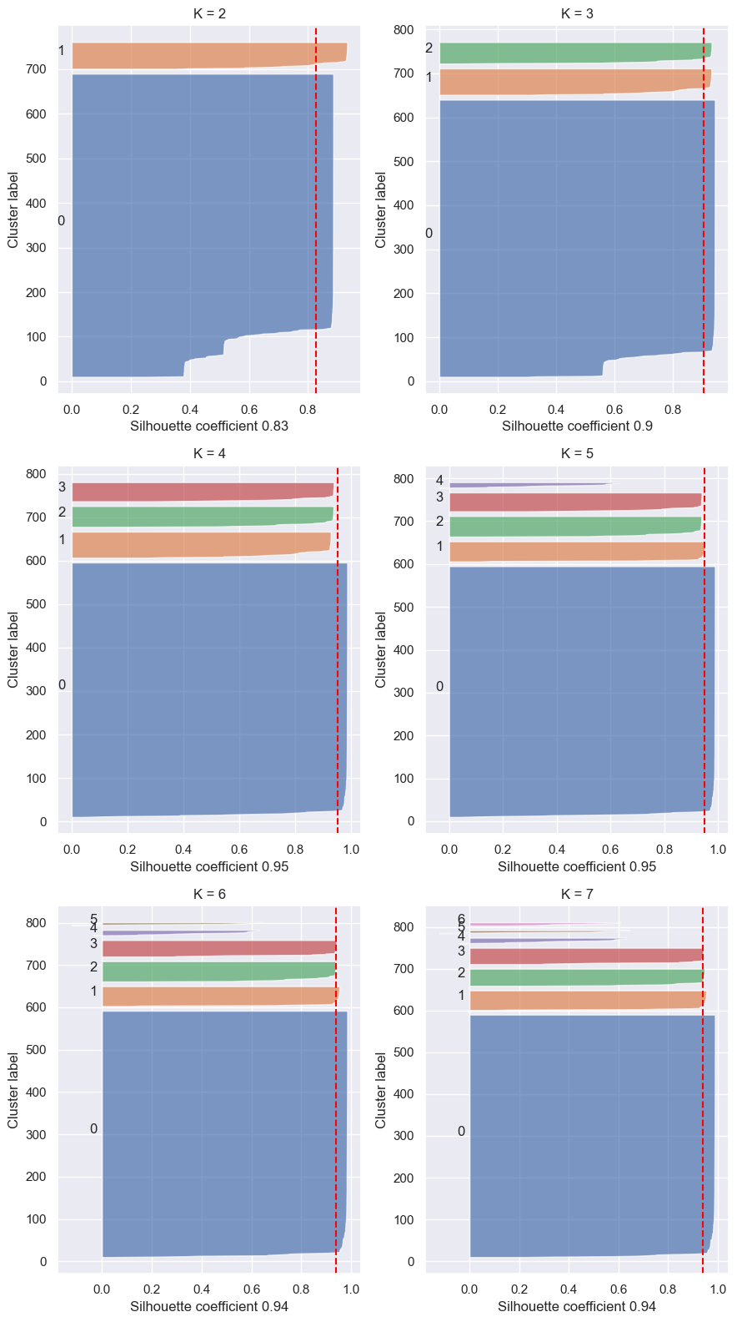
K Means Kernel PCA

Slide 24
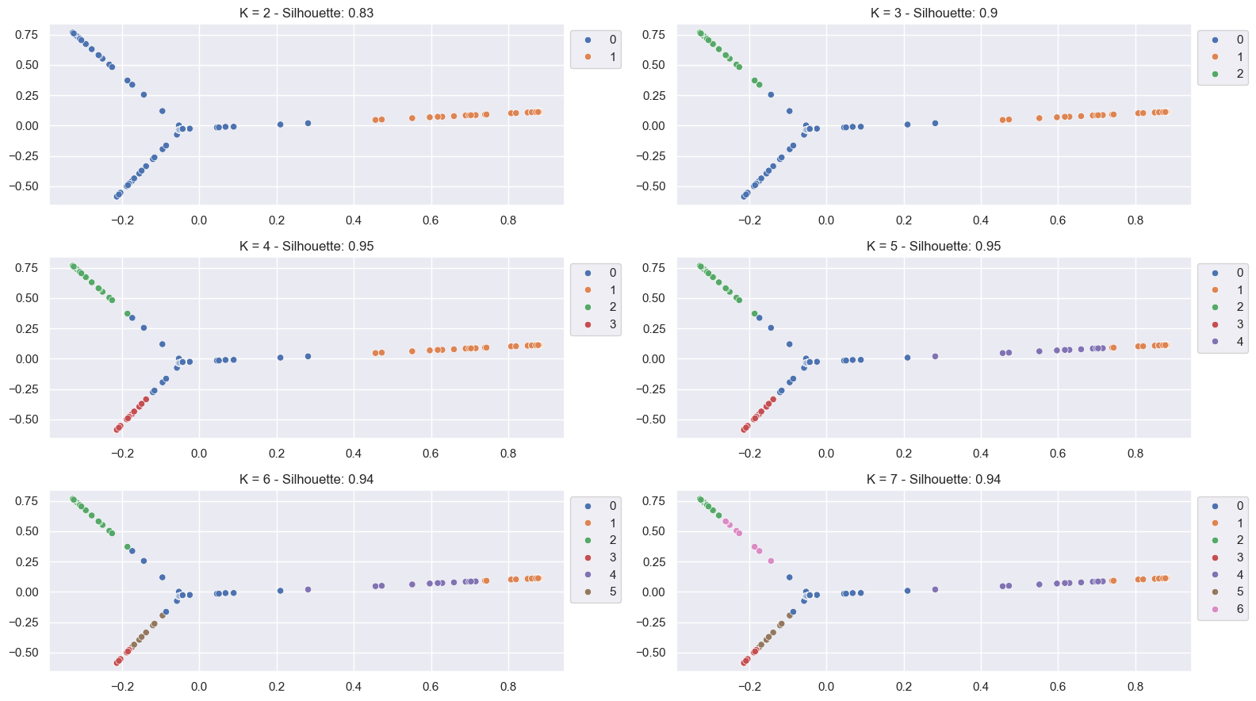
K Means Kernel PCA

Slide 25
Comments
Kernel PCA looks to better separate data points, but visually inspecting clusters it looks like there is some kind of mixing in the “clouds”
Applying K-Means with plain PCA, results in more balanced clusters, that look likes subgroup of a bigger single one

Slide 26
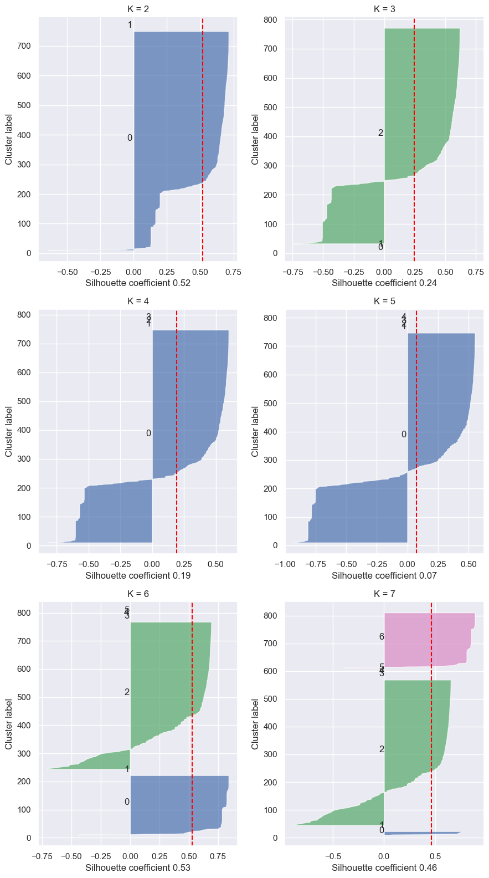
Agglomerative Single linkage PCA

Slide 27
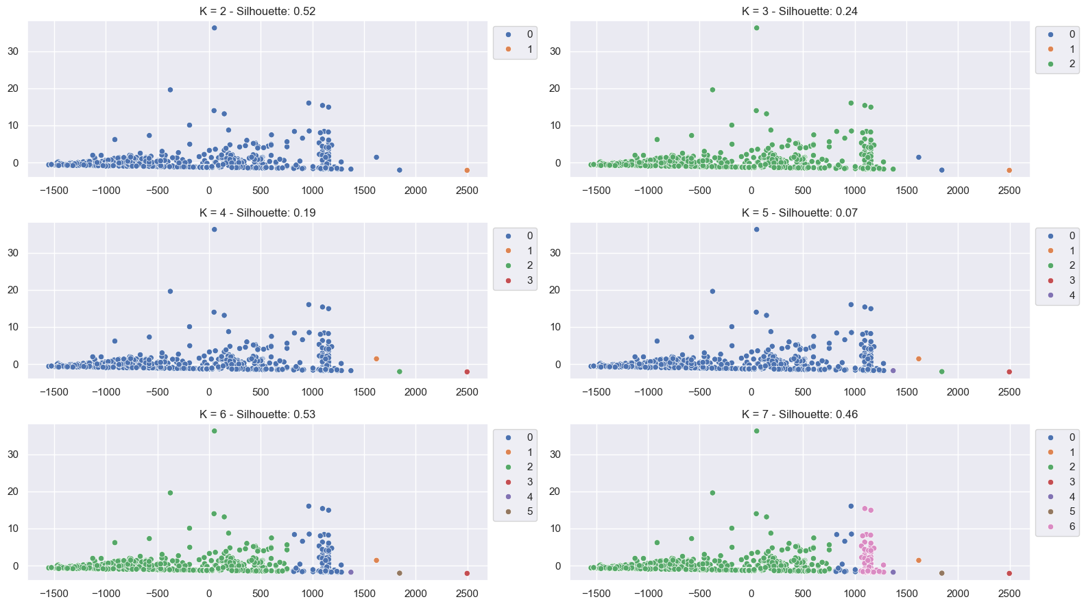
Agglomerative Single linkage PCA

Slide 28
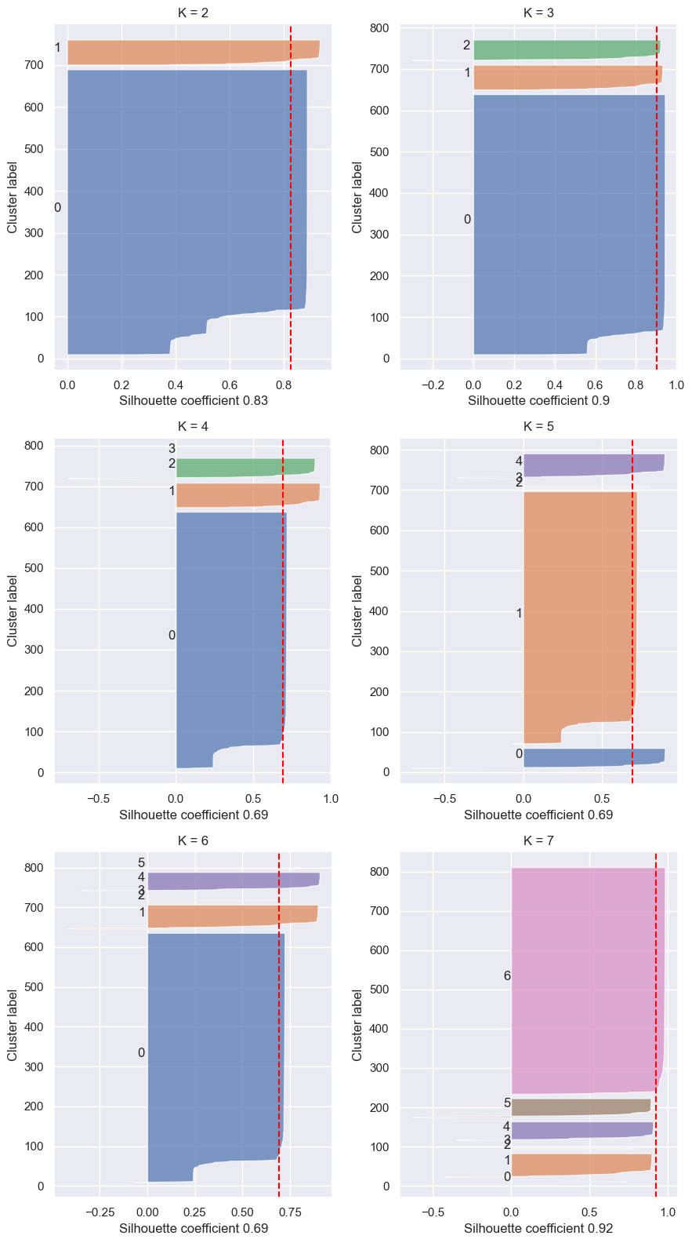
Agglomerative Single linkage Kernel PCA

Slide 29
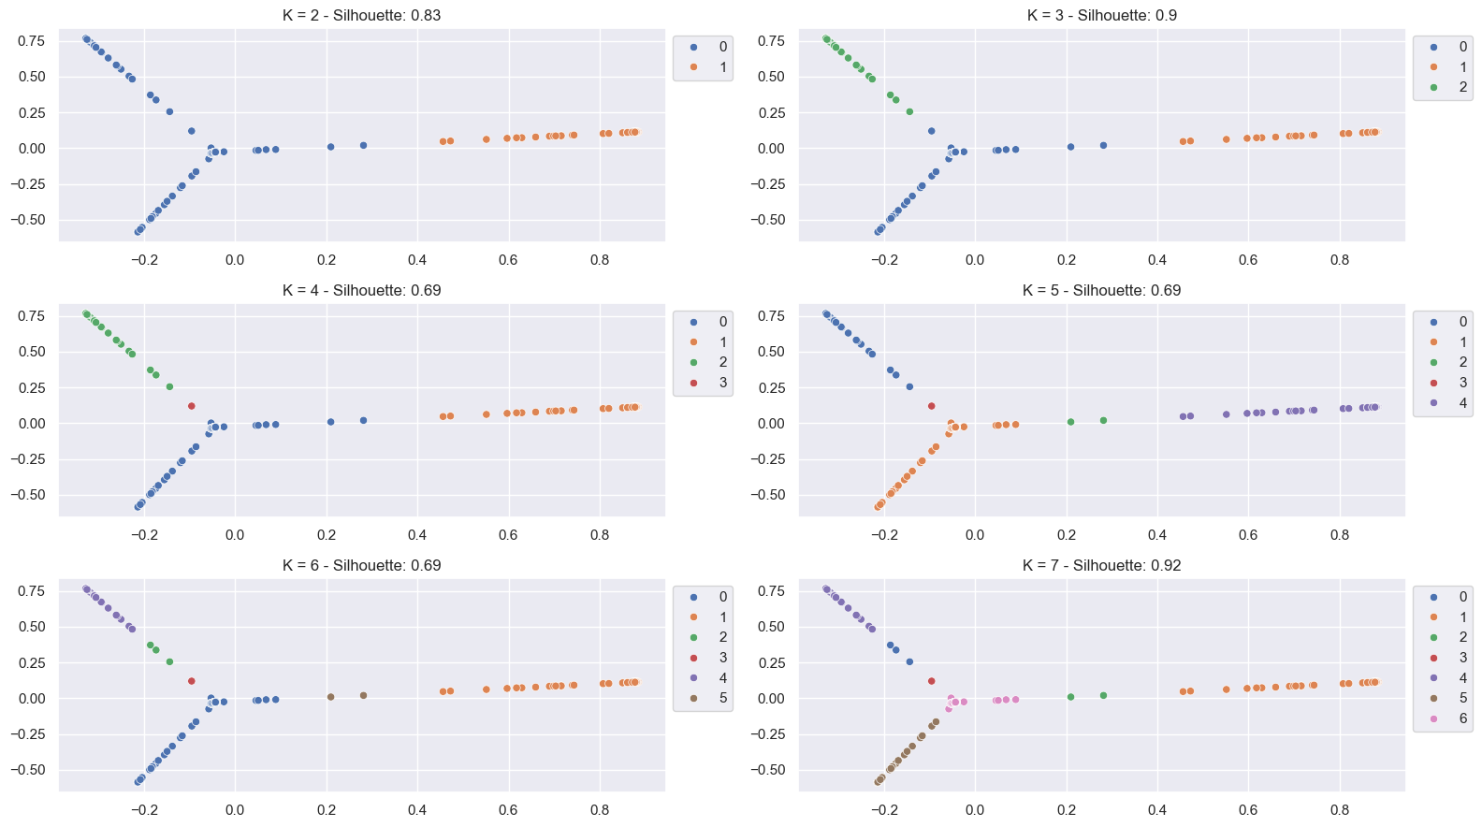
Agglomerative Single linkage Kernel PCA

Slide 30
Comments
Single linkage performs very poorly
Data is noisy and single linkage is prone to ouliers, in fact creates very unbalanced clusters, and in PCA case it creates a single cluster very often

Slide 31
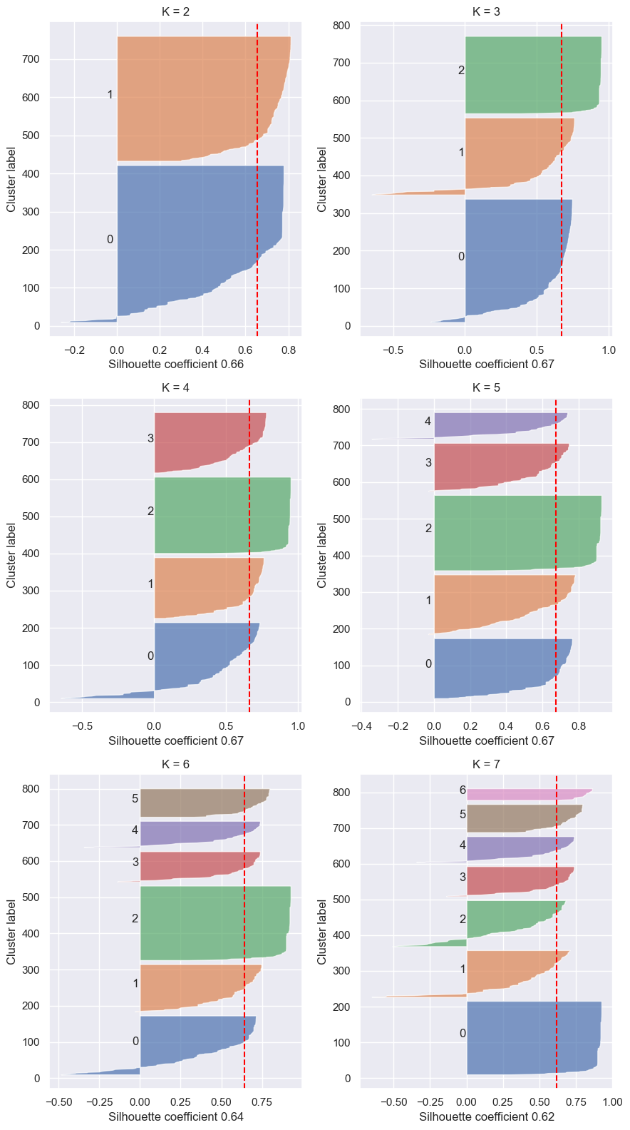
Agglomerative Ward linkage PCA

Slide 32
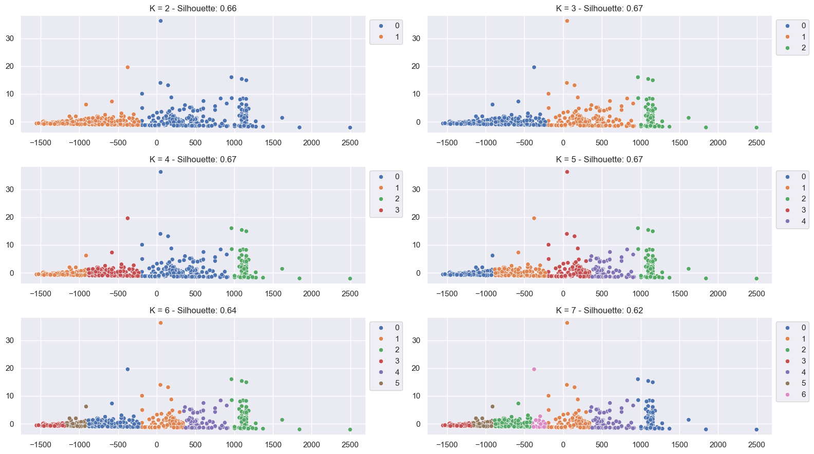
Agglomerative Ward linkage PCA

Slide 33
Agglomerative Ward linkage Kernel PCA

Slide 34
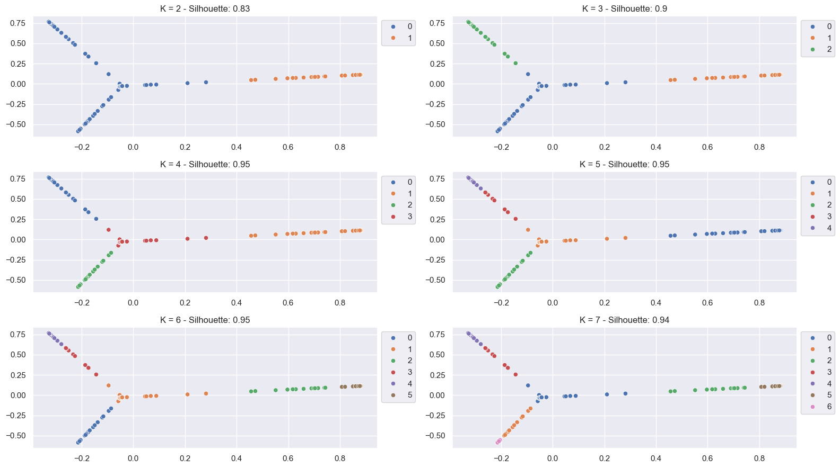
Agglomerative Ward linkage Kernel PCA

Slide 35
Comments
Agglomerative clustering with ward linkage seems more stable and provides good results with the kernel pca
Observing data points' plots and cosindering K=4, Ward clustering provides less mixing than 4-Means using the kernel pca approach, even though the silhoutte score for K = 4 is the the same in both K-Means and Ward the latter;
Silhoutte coefficient is an intuitive internal validation criteria, but like every other methods of the same category, is not good to compare different algorithms, since results will be biased towards a particular one. At least the absolute values gives some insights. But in this case for example a visual analysis were required to discriminate the best tecnique.*

Slide 36
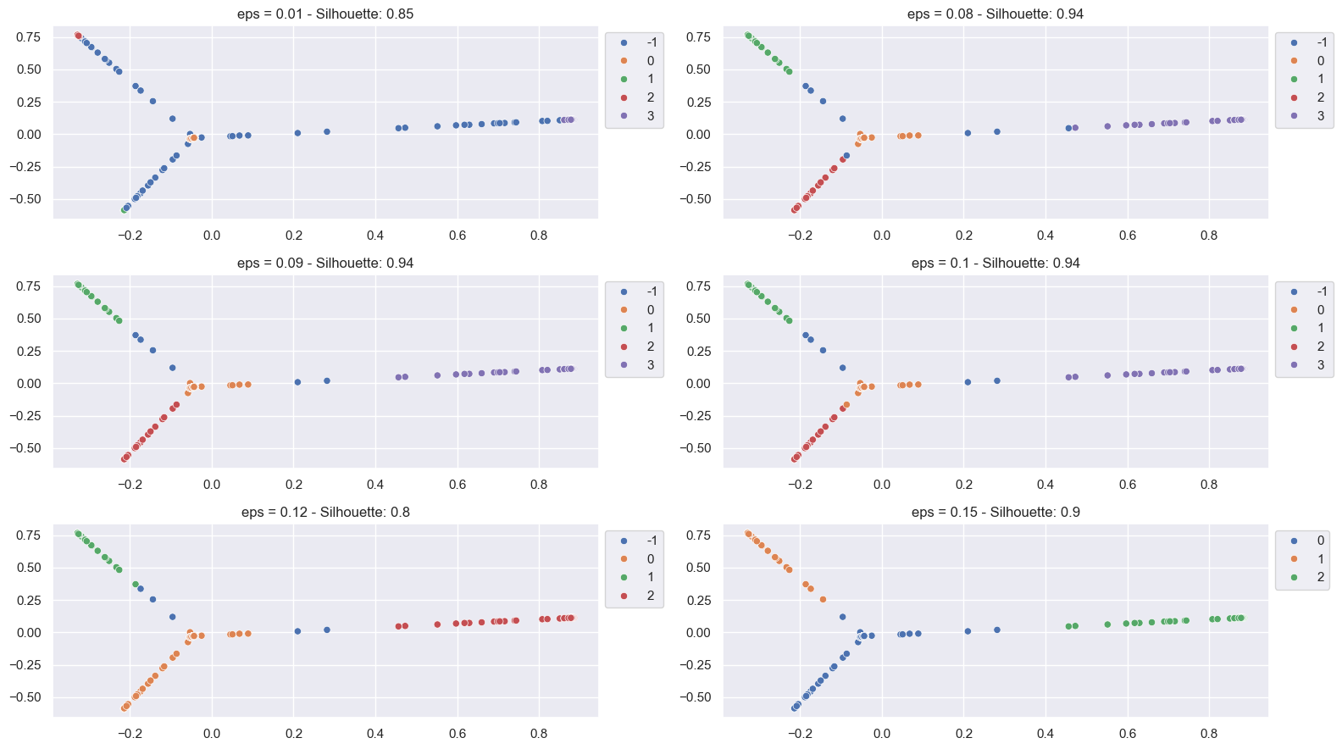
DBSCAN Kernel PCA

Slide 37
Comments
Applying DBSCAN on the kernel pca dataset, provides good results in terms of both silhoutte score and seprations. In particular with eps = 0.09. The advantage in using this tecnique is the fact that noise points are detected automatically. Since no outlier are removed, this property could be really useful.

Slide 38
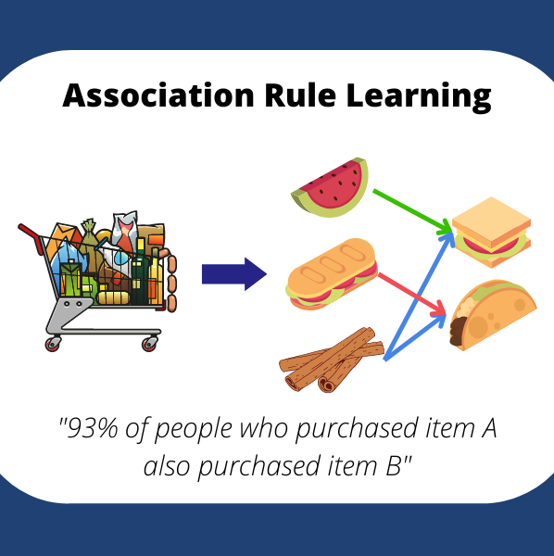
Association rules

Slide 39
Why association rules Note: I’ll report the most interesting ones. Using VS code data wrangler tools other rules can be inspected. I will no
Understand cluster semantics
Trying to understand recurring and interesting patterns in our data
I'll use FPGROWTH as frequent pattern mining algorithm, lowering or increasing min_sup depending on how many (useful) patterns are retrieved.
The association rule will be extracted for the following cases:
3-Means with PCA (here will be provided a very short description)
Agglomerative clustering with Ward linkage and with Kernel PCA

Slide 40
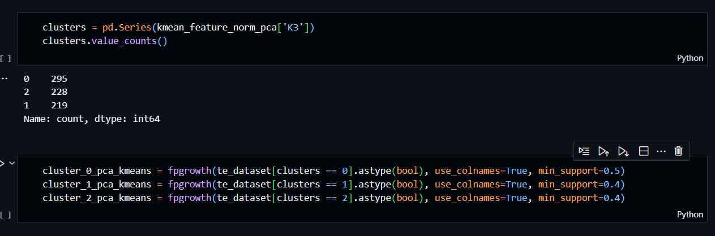
3 Means PCA

Slide 41
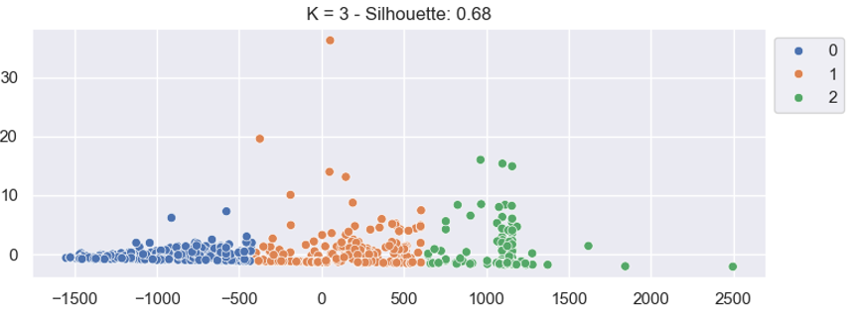
3 Means PCA

Slide 42
Comments
I won’t show specific association rules, since the one found are very similar for every cluster.
We have bucketized the day column in three equal frequency buckets
The first cluster contains data points related to the lowest possible number of day in which the meter is active...obviously the second cluster contains meter who registered consumptions for an average number of day (second bucket) and so on
Association rules are very similar, the only difference is related to this aspect

Slide 43
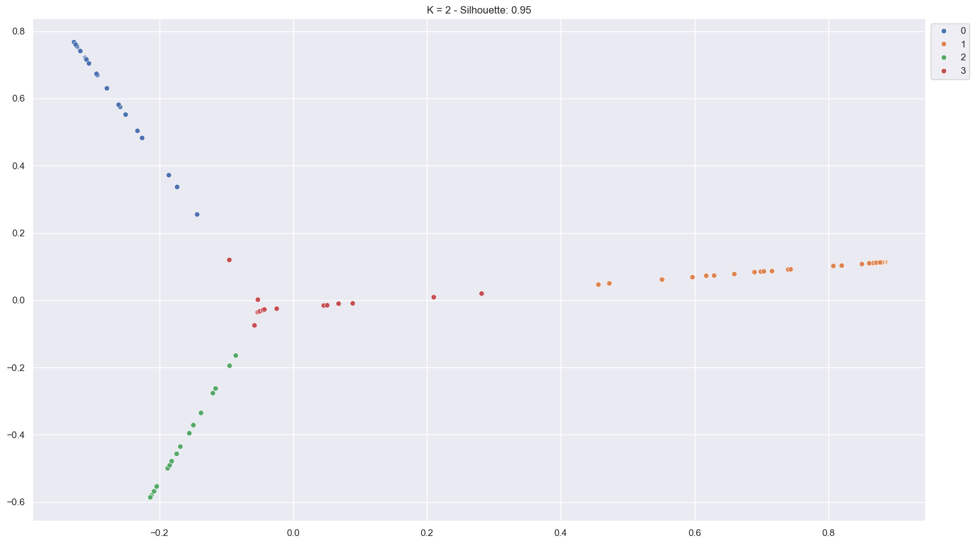
Agglomerative WARD linkage with KPCA (rbf kernel)
The circled cluster holds nearly 600 Data points over the 742 total data points

Slide 44
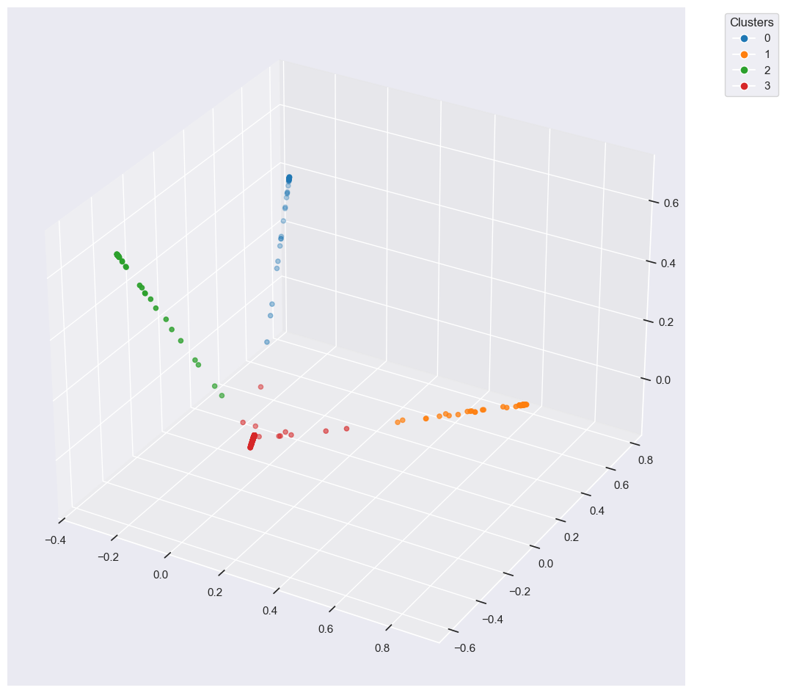
Agglomerative WARD linkage with KPCA (rbf kernel)
By visualising in 3D we can actually appreciate the density of the «central» cluster C3

Slide 45
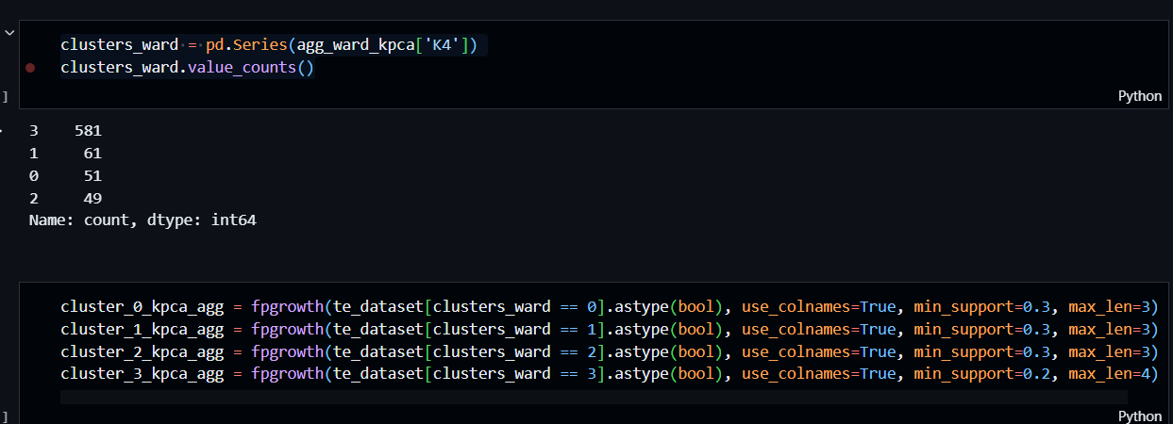
Agglomerative WARD KPCA

Slide 46
Agglomerative WARD linkage with KPCA (rbf kernel): cluster 0
Antecedent | Consequent | Confindence | Support
Borough_QUEENS, CONSUMPTION (1062, 5271] | IS_METER_AMR | 90% | 34%
Borough_QUEENS | IS_METER_AMR | 93% | 61%
current_charges_(9610.33, 46454.87] | consumption_(hcf)_(1061.6, 5270.8],is_federal | 100% | 48%
service_start_date_12/13/2012 | #_days_(2077.0, 4057.0],service_end_date_10/22/2019 | 95% | 75%
current_charges_(3040.262, 9610.33] | service_start_date_12/13/2012 | 90% | 33%

Slide 47
Comments
It looks like AMR meters are very common in Queens, and this cluster groups meter that registered a moderate consumption level
A large subset of this clustered data seems to follow a period from early winter 2012 and early Autumn 2019

Slide 48
Agglomerative WARD linkage with KPCA (rbf kernel): cluster 1
Antecedent | Consequent | Confindence | Support
consumption_(hcf)_(242.8, 1061.6], current_charges_(3040.262, 9610.33] | is_meter_amr | 100% | 40%
is_not_only_water_sewer_charges | #_days_(2077.0, 4057.0], is_meter_amr | 100% | 40%
is_only_water_sewer_charges | #_days_(2077.0, 4057.0], is_meter_amr | 97% | 57%
service_start_date_11/14/2012 current_charges_(9610.33, 46454.87] | service_end_date_10/22/2019 | 96% | 38%
service_end_date_10/22/2019, consumption_(hcf)_(1061.6, 5270.8] | current_charges_(9610.33, 46454.87] | 100% | 38%

Slide 49
Comments Question: why did I reported a.r. based on consumptions?
It looks like clusters are grouped based on the time period and number of days of activation
While the cluster c0 mainly focus on a single category of consumption, this cluster is more “mixed”. Two groups are identified in this cluster:
Meters with additional charges beyond water/sewer
Basic water/sewer accounts, which are more common
There are also rules that specify different consumptions and costs in the time period followed by the cluster, potentially corresponding to residential versus commercial/federal usage patterns.
Note: cluster contains rules related to QUEENS like the previous one.

Slide 50
Agglomerative WARD linkage with KPCA (rbf kernel): cluster 2
Antecedent | Consequent | Confindence | Support
service_start_date_01/14/2013 | service_end_date_10/22/2019, is_meter_amr | 90% | 75%
service_start_date_01/14/2013, bill_analyzed_score_(0.499, 0.953] | is_meter_amr | 100% | 30%
service_start_date_01/14/2013, bill_analyzed_score_(0.953, 0.969] | is_meter_amr | 100% | 30%

Slide 51
Comments
Rules found are basically the same of cluster 0 but follow a different time period, in which analyzed consumption are in the same range of consumption (and charges) in cluster 0… (still in QUEENS)
Graphically this cluster is not far away from the c0
Like in the previous case there are two groups of meters here:
The one that analyze an average number of bills
The one that analyze basically every bill (this case is common to other clusters)

Slide 52
Agglomerative WARD linkage with KPCA (rbf kernel): cluster 3
Antecedent | Consequent | Confindence | Support
borough_BROOKLYN | is_meter_amr | 82% | 22%
borough_QUEENS | is_meter_amr | 70% | 30%
#_days_(5.999, 980.0] | is_only_water_sewer_charges, is_meter_amr | 75% | 35%
#_days_(980.0, 2077.0] | is_only_water_sewer_charges, is_meter_amr | 60% | 25%
consumption_(hcf)_(5270.8, 16346.2] | current_charges_(46454.87, 158822.24] | 100% | 38%
consumption_(hcf)_(16346.2, 487833.0] | current_charges_(158822.24, 1713233.95] | 97% | 20%
consumption_(hcf)_(5270.8, 16346.2], is_meter_amr | current_charges_(46454.87, 158822.24] | 95% | 20%

Slide 53
Comments
Brooklyn and Queens are the most represented boroughs. Brooklyn has a stronger association with AMR meters (82%) than Queens (70%), but Queens represents a larger share of the cluster.
This might suggest differences in AMR rollout strategies or infrastructure across boroughs.
Very high consumption (and charges)… maybe meters are located in buildings used for some kind of commercial activity

Slide 54
Final comments

Slide 55
What did we have discovered?
For each cluster we have identified how for a certain consumption range there is a certain charges range
AMR Meters Are Predominant, but Distribution Varies by Borough
AMR meters are often linked with federal funding for developments
Groups in the data look like they are formed considering a specific time period or number of day in which the meter Is active
Linear shaped cluster are characterized by a constant #_days interval
The dense cluster is characterized by groups of different, and smaller, #_days interval but meter in this cluster appear to register high levels of water consumption

Slide 56
Possible improvements
We have not discovered much from this dataset.
But at least we have some into that can be used to improve the analysis.
Improving data quality
Engineer new kind of features (e.g. seasons...)
Apply different combinations of standardizations
This could lead to different groups
Add more data…

Slide 57
Possible applications
Billing Optimization
Plan future maintenance
Infrastructure management

Slide 58
Thank you
Giacomo Detomaso
giacomodetomaso24@gmail.com

